Slide 1
SCSA1304
ADVANCED DATA STRUCTURES
B.E CSE 2019-2023
III SEMESTER

Slide 2
COURSE OBJECTIVES
➢ To acquire knowledge of organizing the data in non
linear fashion.
➢ To get the idea of balancing the height of trees to
optimize the structure and search time.
➢ To learn the process of establishing the network with
various nodes with minimum cost and finding the
shortest path.
➢ To understand the method of designing the table
data structure and its applications.

Slide 3
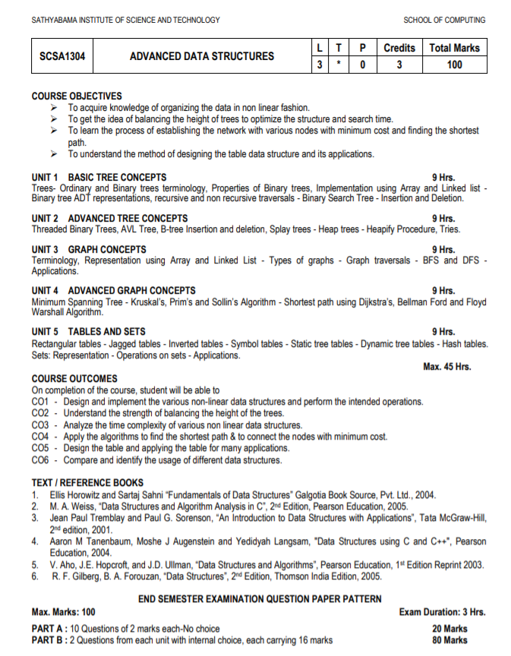

Slide 4
Trees
Non Linear Data structures
Graphs
Set
Tables

Slide 5
TREE
Director
Non Linear Data Structure
Multiple Level
Collection of entities or nodes linked to gather to stimulate a hierarchy relation
Top – Down Approach
Nodes store information
Unidirectional
Dean
HOD
HOD
FACULTY

Slide 6
Tree - Terminology
In linear data structure data is organized in sequential order and in non-linear data structure data is organized in random order.
A tree is a very popular non-linear data structure used in a wide range of applications. A tree data structure can be defined as follows :
Tree data structure is a collection of data (Node) which is organized in hierarchical structure recursively.
A tree ‘t’ is a finite nonempty set of elements.
One of these elements is called the root.
The remaining elements, if any, are partitioned into trees, which are called the subtrees of ‘t’.
In tree data structure, every individual element is called as Node. Node in a tree data structure stores the actual data of that particular element and link to next element in Hierarchical structure. In a tree data structure, if we have N number of nodes then we can have a maximum of
N-1 number of links.

Slide 7
TREES
Trees
Tree and Binary Trees terminology
Properties of Binary trees
Implementation using Array and Linked list
Binary tree
ADT representations
Recursive and Non Recursive Traversals
Binary Search tree
Insertion
Deletion

Slide 8

Top Down Approach
Director
Dean
HOD
HOD
FACULTY

Slide 9
Terminology of Tree
Director
A
Root: No Parent, Top Most Element or First Element in Hierarchy
Node: Store Information
Parent Node: Immediate predecessor of any node
Child Node: Immediate Successor of node
Branch: Relationship between parent and child. Also called as Edges
Leaf Node/ External Node: No children
B
Dean
C
D
E
F
G
HOD
HOD
H
I
J
K
L
M
N
O
FACULTY

Slide 10
Terminology of Tree
Internal Node: Children (Non Leaf Node)
Path: Sequent of consecutive edges from source to destination
Ancestor: Any predecessor node on the path from root to that node
Descendant: Any Successor node on the path from that node to leaf node
Subtree: Subset of tree that is itself a tree (Descendant)
Sibling: All children of same parent
Cousins: Children's of different parent
Degree: No. of Children of that node (Tree-Max)
Director
A
B
Dean
C
D
E
F
G
HOD
HOD
H
I
J
K
L
M
N
O
FACULTY

Slide 11
Terminology of Tree
Depth of Node: Length of path from root to that node
Height of Node: No. of Edges in the longest path from that node to leaf node
Level of Node: Distance from root to the given node (No. of Edges)
Level = Depth ->node and edges
N Nodes means N-1 Edges
Director
Level 0
A
Level 1
B
C
Dean
Level 2
D
E
F
G
HOD
HOD
Level 3
H
M
N
O
I
J
K
L
File system, Quick Search, Organize (Binary tree, Heap tree)
FACULTY

Slide 12
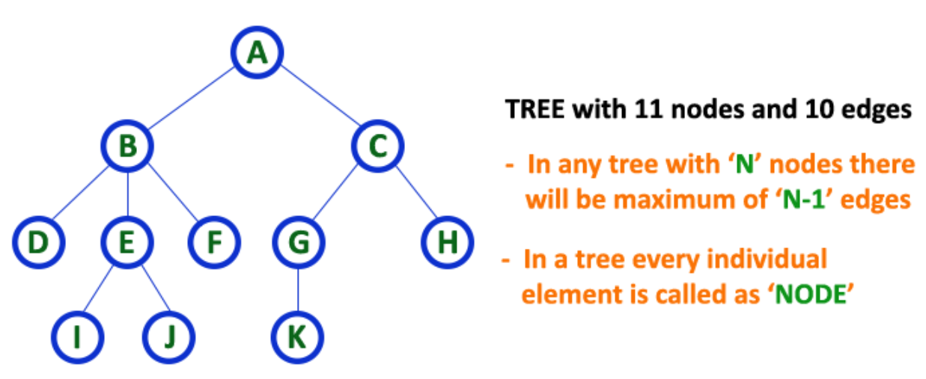
Terminology of Tree
Notes:
Root
Children
Leaf Node
Parent Node
Ancestors
Climbing
Descending

Slide 13
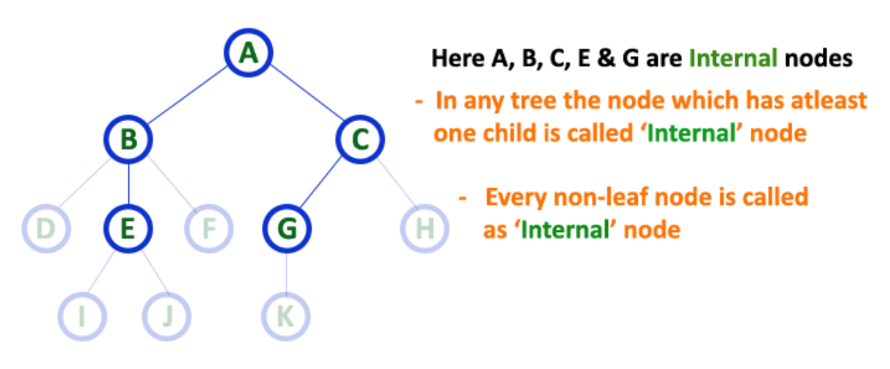
Terminology of Tree
Notes:
Internal Nodes
In a tree data structure, the node which has atleast one child is called as INTERNAL Node.
In simple words, an internal node is a node with atleast one child. In a tree data structure, nodes other than leaf nodes are called as Internal Nodes.
The root node is also said to be Internal Node if the tree has more than one node. Internal nodes are also called as 'Non-Terminal' nodes.

Slide 14
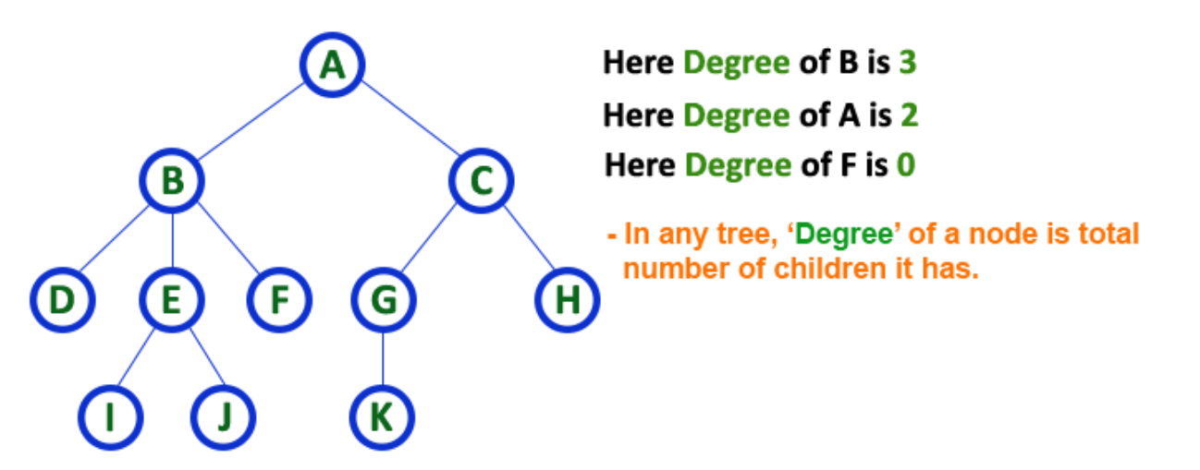
Terminology of Tree
Notes:
In a tree data structure, the total number of children of a node is called as DEGREE of that Node. In simple words,
the Degree of a node is total number of children it has. The highest degree of a node among all the nodes in a tree is called as 'Degree of Tree'

Slide 15
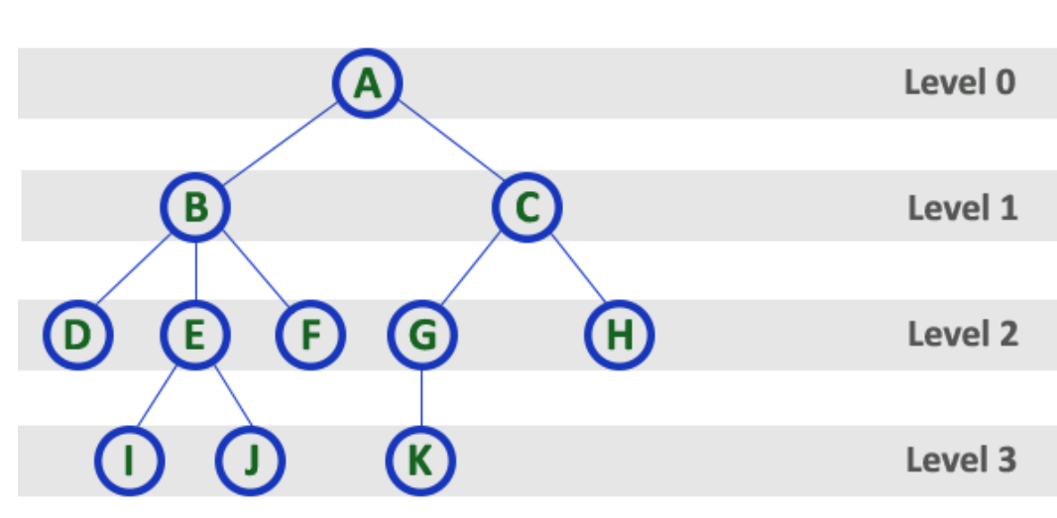
Terminology of Tree
Notes:
In a tree data structure, the root node is said to be at Level 0 and the children of root node are at Level 1 and
the children of the nodes which are at Level 1 will be at Level 2 and so on...
In simple words, in a tree each step from top to bottom is called as a Level and the Level count starts with '0' and incremented by one at each level (Step).

Slide 16
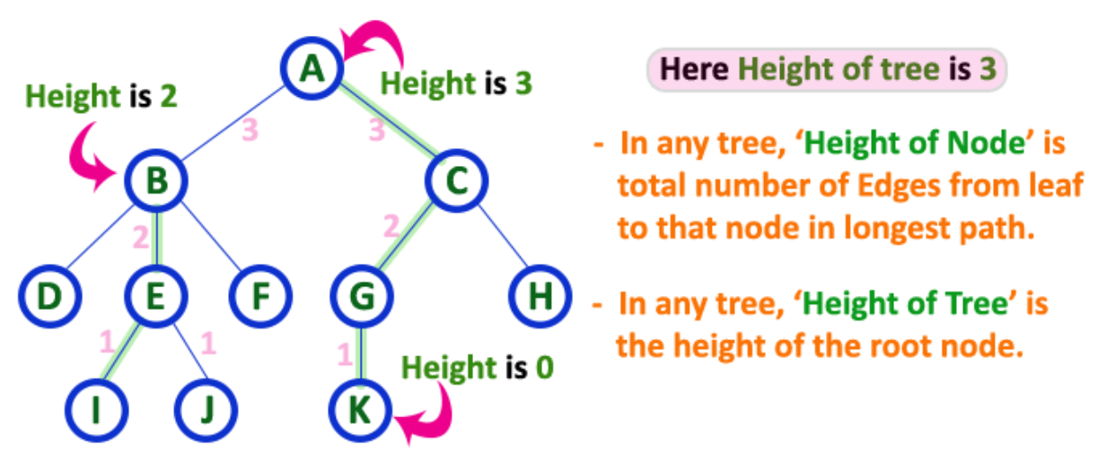
Terminology of Tree
Notes:
In a tree data structure, the total number of edges from leaf node to a particular node in the longest path is called as HEIGHT of that Node.
In a tree, height of the root node is said to be height of the tree. In a tree, height of all leaf nodes is '0'.

Slide 17
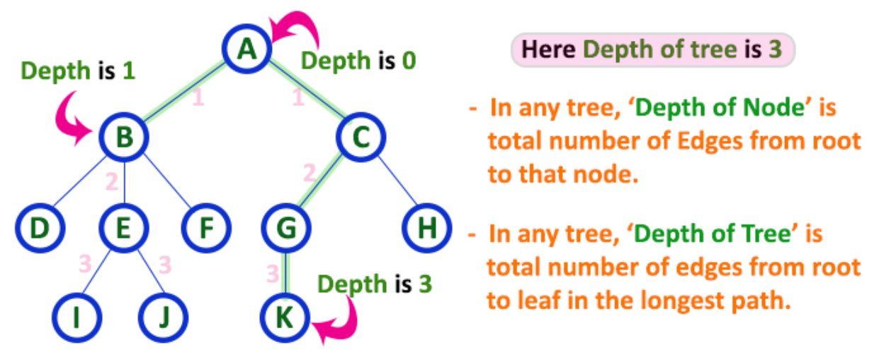
Terminology of Tree
Notes:
In a tree data structure, the total number of egdes from root node to a particular node is called as DEPTH of that Node.
In a tree, the total number of edges from root node to a leaf node in the longest path is said to be Depth of the tree.
In simple words, the highest depth of any leaf node in a tree is said to be depth of that tree. In a tree, depth of the root node is '0'.

Slide 18
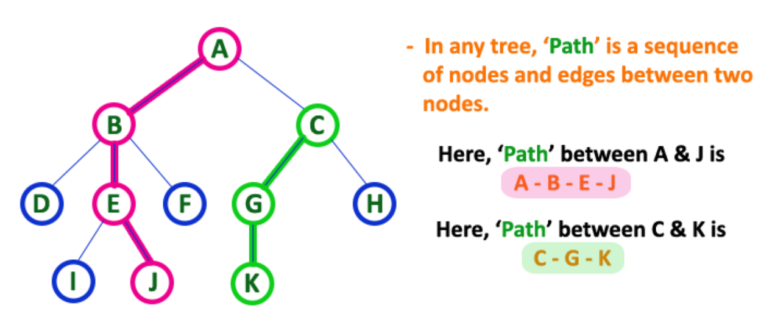
Terminology of Tree
Notes:
In a tree data structure, the sequence of Nodes and Edges from one node to another node is called as PATH between that two Nodes.
Length of a Path is total number of nodes in that path. In below example the path A - B - E - J has length 4.

Slide 19
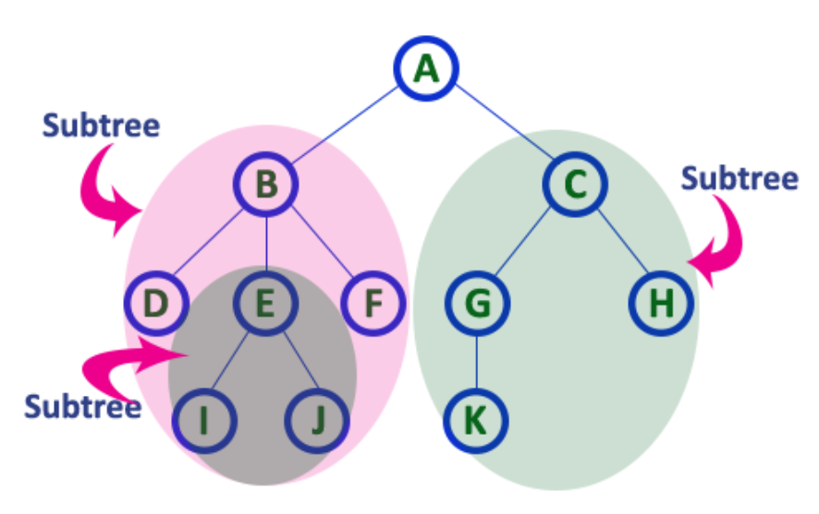
Terminology of Tree
Notes:
In a tree data structure, each child from a node forms a subtree recursively. Every child node will form a subtree on its parent node.

Slide 20
BINARY TREE
Finite collection of elements.
A nonempty binary tree has a root element.
The remaining elements are partitioned into two binary trees.
These are called the left and right subtrees of the binary tree.

Slide 21
BINARY TREE Vs TREE
BINARY TREE | TREE
No node in a binary tree may have a degree more than 2 | No limit on the degree of a node in a tree
A binary tree may be empty | A tree cannot be empty
The subtrees are ordered | The subtrees are not ordered
Left & Right Binary Trees | No difference. Treated in a similar manner
a
a
b
b
Representations of Tree :
Array Representation
Linked List Representation

Slide 22

Array Representation
If a complete binary tree with n nodes is represented sequentially, then for any node with index i, 1 ≤ i ≤ n,
PARENT(i) is at | i / 2 | if i > 1.
If i = 1, i is at the root and has no parent.
LEFTCHILD(i) is at 2i if 2i ≤ n,
if 2i > n, i has no left child
RIGHTCHILD(i) is at 2i + 1 if 2i +1 ≤ n,
if 2i +1 > n, i has no right child

Slide 23
Example 1
1
2
3
4
5
6
7
8
9
10
11
12
13
14
15

Slide 24
Example 1
index | tree
[0] | --
[1] | A
[2] | B
[3] | C
[4] | D
[5] | E
[6] | F
[7] | G
[8] | H
[9] | I
[10] | J
[11] | K
[12] | L
[13] | M
[14] | N
[15] | O
A
B
C
D
E
F
G
H
I
J
K
L
M
N
O

Slide 25
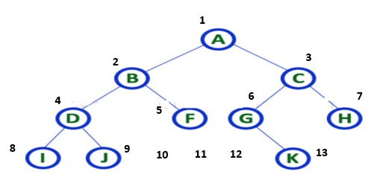

Representation of Tree – Arrays
11
12
13
1 | 2 | 3 | 4 | 5 | 6 | 7 | 8 | 9 | 10 | 11 | 12 | 13 | 14 | 15
Notes:
In array representation of a binary tree, we use one-dimensional array (1-D Array) to represent a binary tree. Consider the above example of a binary tree and it is represented as follows...
To represent a binary tree of depth 'n' using array representation, we need one dimensional array with a maximum size of 2n + 1.

Slide 26
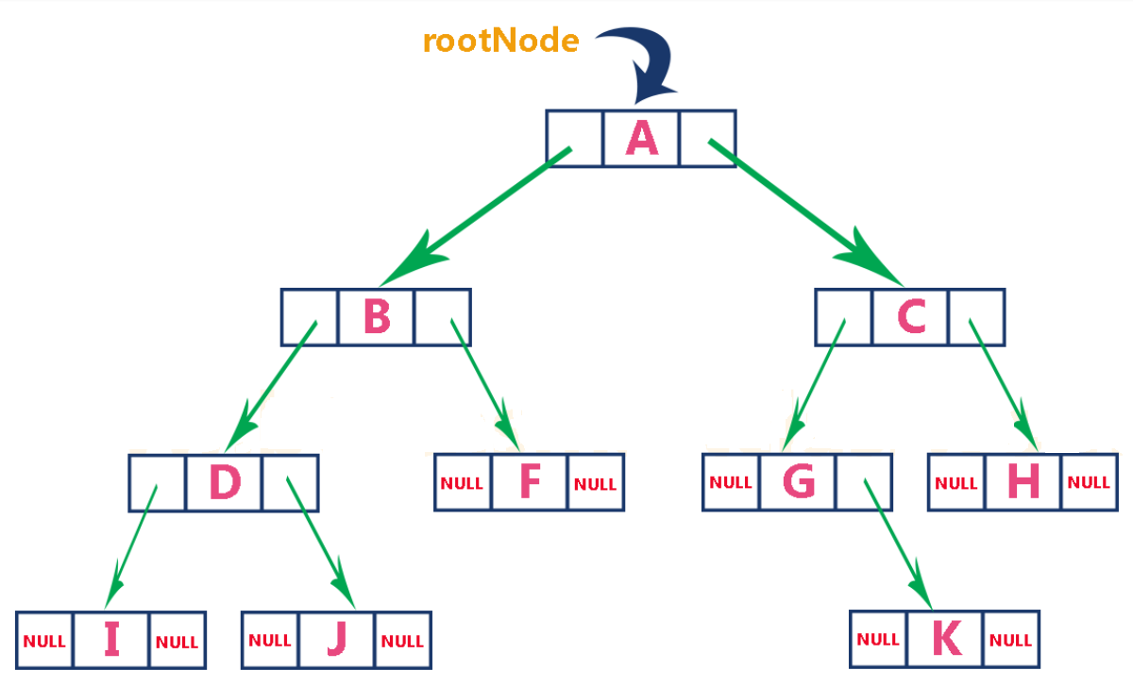
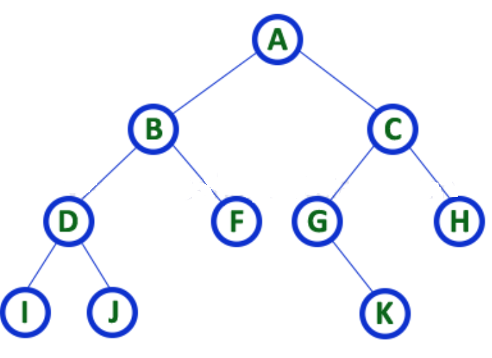

Representation of Tree – Linked List
Notes:
We use a double linked list to represent a binary tree. In a double linked list, every node consists of three fields. First field for storing left child address, second for storing actual data and third for storing right child address. In this linked list representation, a node has the following structure...

Slide 27
BINARY TREE
A
A
B
STRICTLY BINARY TREE
C
B
It is a tree in each node having at most of two children (0,1,2)
Representation:
SKEWED BINARY TREE
A
A
A(L) | Node | A(R)
B
D
X | Node | A(R)
A
A
Ex. 1:
X
X
A(Node B) | A | A(Node C)
B
C
D
B
C
D
Where X indicates not a binary tree

Slide 28
BINARY TREES
Ex. 2:
A
A
A(Node B) | Node A | -
B
STRICTLY BINARY TREE
C
B
Ex. 3:
A(Node B) | Node A | -
SKEWED BINARY TREE
A
A
A(Node D) | Node B
B
D

Slide 29
BINARY TREES
Benefits of Binary Trees
An ideal way to store data in a hierarchical way.
Reflect structural relationships that exist in the given data set
Make insertion and deletion faster than list and Array pattern.
A flexible way of holding and moving data
Used to store as many nodes as possible
Faster than linked lists and slower than arrays when we try to accessing elements

Slide 30
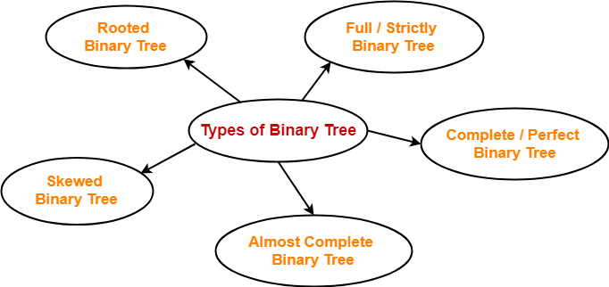
BINARY TREES - TYPES

Slide 31
Special Binary Tree
Skewed Tree
Left Skewed
Right Skewed
Complete Binary Tree – all levels complete, except last with left nodes
Full Binary Tree – complete at all levels (with 2 nodes)
Perfect Binary tree – all leaves at the same level
Rooted Binary Tree – only root is allowed to have degree 2 others <2

Slide 32
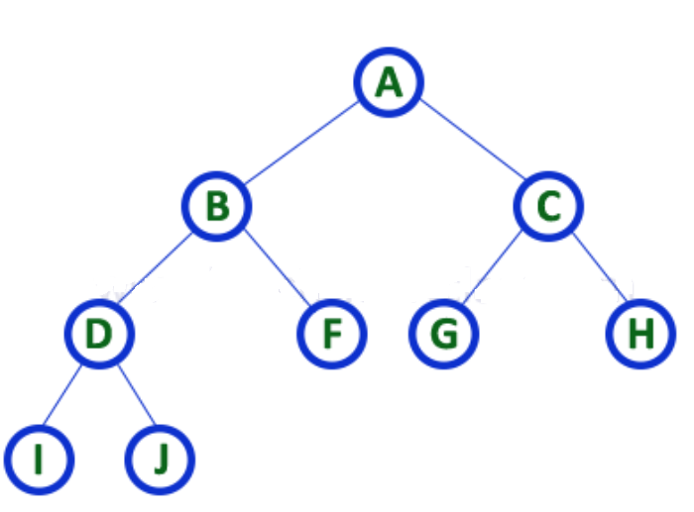
STRICTLY BINARY TREES
Strictly binary tree is also called as Full Binary Tree or Proper Binary Tree or 2-Tree
A binary tree in which every node has either two or zero number of children is called Strictly Binary Tree
Notes:
In a binary tree, every node can have a maximum of two children. But in strictly binary tree, every node should have exactly two children or none. That means every internal node must have exactly two children.
Strictly binary tree is also called as Full Binary Tree or Proper Binary Tree or 2-Tree
A strictly Binary Tree can be defined as follows...
A binary tree in which every node has either two or zero number of children is called Strictly Binary Tree

Slide 33
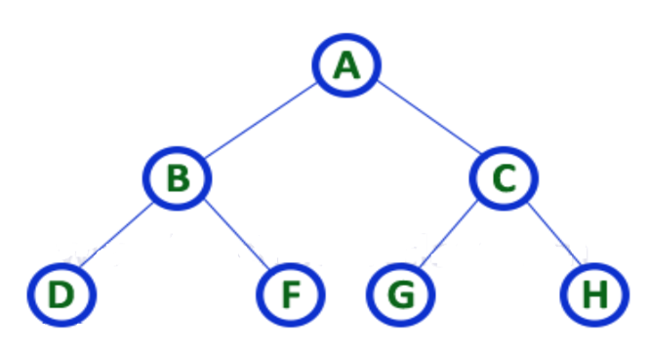
PERFECT BINARY TREES
Perfect binary trees are binary trees whose leaves are present at the same level and whose internal nodes carry two children.
Notes:
Perfect binary trees: Perfect binary trees are binary trees whose leaves are present at the same level and whose internal nodes carry two children.
A common example of a perfect binary tree is an ancestral family tree.

Slide 34
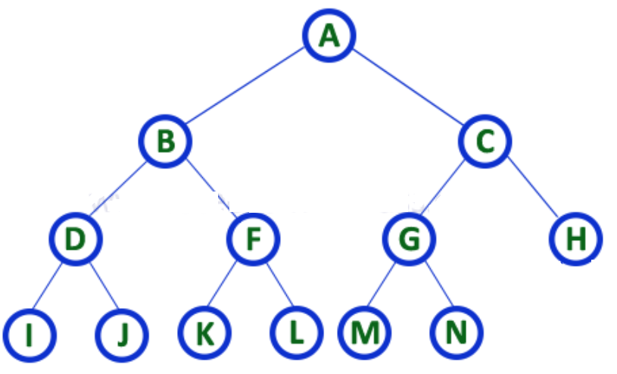
COMPLETE BINARY TREES
A binary tree in which every internal node has exactly two children and all leaf nodes are at same level is called Complete Binary Tree.
Notes:
In a binary tree, every node can have a maximum of two children. But in strictly binary tree, every node should have exactly two children or
none and in complete binary tree all the nodes must have exactly two children and at every level of complete binary tree there must be
2^{level} number of nodes. For example at level 2 there must be 2² = 4 nodes and at level 3 there must be 2³ = 8 nodes.
A binary tree in which every internal node has exactly two children and all leaf nodes are at same level is called Complete Binary Tree.
Complete binary tree is also called as Perfect Binary Tree

Slide 35
LEFT SKEWED TREE
A
B
C
D

Slide 36
RIGHT SKEWED TREE
A
B
C
D
E

Slide 37
PROPERTIES OF BINARY TREE
Maximum No. of nodes possible at any level is N = [2 power (i)]
i.e (2^i)

Slide 38
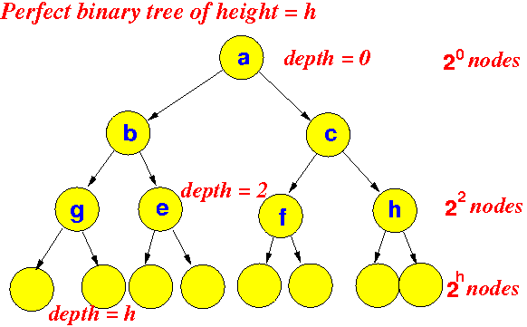

Slide 39
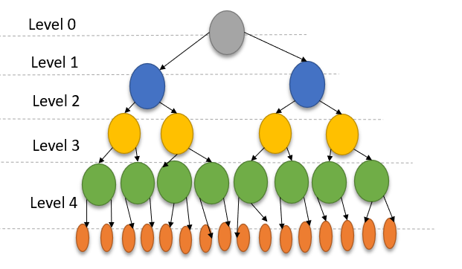
PROPERTIES OF BINARY TREE
2. Maximum No. of Nodes at height h is N = ((2^(h+1)) -1)
= 0 + 1 + 2 + 3 + 4
= 2^0 + 2^1 + 2^2 + 2^3 + 2^4
= 1 + 2 + 4 + 8 + 16 (GP SERIES)
EX. HEIGHT = LEVEL
WHERE H = 4
(2^(4 + 1)) – 1 = 31 NODES

Slide 40
PROPERTIES OF BINARY TREE
3. MINIMUM NO. OF NODES AT HEIGHT H IS N = H + 1
Height = Level
LEVEL 0
Ex. 1 : Level = 0 then h = 0
Ans : 1
Ex. 2 : Level = 1 then h =1
Ans: 2
Ex. 3 : Level = 2 then h = 2
Ans: 3
Ex. 4 : Level = 3 then h = 3
Ans: 4
LEVEL 1
LEVEL 0
LEVEL 1
LEVEL 2
LEVEL 3

Slide 41
PROPERTIES OF BINARY TREE
4. Maximum Height of N nodes:
(Min. No. of Nodes in Height H) (N = h + 1) is H = N – 1
Level 0
Ex., N = 5 then H = 4
Level 1
Level 2
Level 3
Level 4

Slide 42
PROPERTIES OF BINARY TREE
5. Number of edges possible at n elements : E = N - 1
Ex., N = 5 Then E = 4
1
2
3
4

Slide 43
PROPERTIES OF BINARY TREE
6. Number of Internal Nodes (Children) in
Complete Binary Tree is N / 2
1
2
Nodes = 5
So 5/2=2.5
Round to 2
Internal Nodes = 2
3
4
Notes:
N/2
4/2
2 Internal nodes

Slide 44
PROPERTIES OF BINARY TREE
7. Number of Leaf Node (No children) in a perfect Binary
tree is L = (N + 1) / 2
1
2
N = 5
L = (5 + 1) / 2
L = 3
3
4
Notes:
A binary tree with ‘L’ leaves has at least log2L+1log2⁡L+1 number of levels
The maximum number of nodes at level ‘l’ will be 2l−12l−1 . Here level is the number of nodes on path from root to the node, including the root itself. We are considering the level of root is 1.
Maximum number of nodes present in binary tree of height h is 2h−12h−1 . Here height is the max number of nodes on root to leaf path. Here we are considering height of a tree with one node is 1.
In a binary tree with n nodes, minimum possible height or minimum number of levels arelog2⟮n+1⟯log2⁡⟮n+1⟯ . If we consider that the height of leaf node is considered as 0, then the formula will be log2⟮n+1⟯−1log2⁡⟮n+1⟯−1
A binary tree with ‘L’ leaves has at least log2L+1log2⁡L+1 number of levels
If a binary tree has 0 or 2 children, then number of leaf nodes are always one more than nodes with two children.

Slide 45
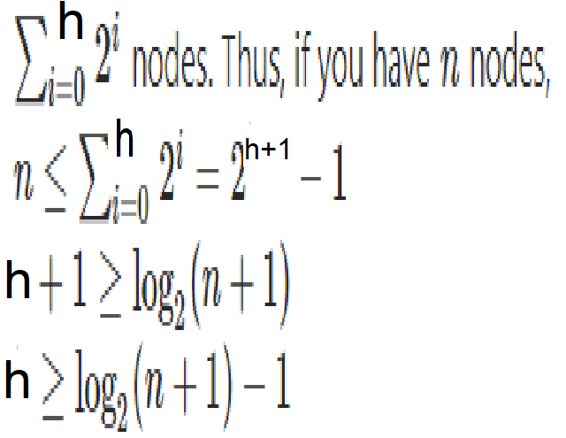
PROPERTIES OF BINARY TREE
8. Minimum Height of N nodes:
(Max. No. of Nodes in Height H) is N = ((2^(h+1)) -1)
THEN H= ?????
Level 0
Level 1
Level 2
Level 3
Level 4
Notes:
In a Binary Tree with N nodes, minimum possible height or minimum number of levels is ?
Log₂(N+1) ? This can be directly derived from point 2 above. If we consider the convention where height of a leaf node is considered as 0, then above formula for minimum possible height becomes ? Log₂(N+1) ? – 1
In a binary tree with n nodes, minimum possible height or minimum number of levels arelog2⟮n+1⟯log2⁡⟮n+1⟯ . If we consider that the height of leaf node is considered as 0, then the formula will be log2⟮n+1⟯−1

Slide 46
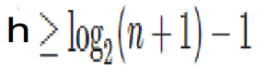
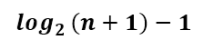
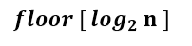
PROPERTIES OF BINARY TREE
Level 0
Level 1
If no of nodes =5
Log (5+1) to base 2 =2.58
So take upper bound =3
So height = 3-1
Therefore =2
Level 2
Height of a perfect binary tree having ’n’ nodes is -
Height of a complete binary tree having ’n’ nodes is -

Slide 47
BINARY TREE TRAVERSALS
60 70 80 90 100 120 75 50 85

Slide 48
BINARY TREE - ADT
Class BinaryTree
{
Objects
A finite set of nodes either empty or consisting of a root
node, left BinaryTree and right BinaryTree
Methods
BinaryTree() // Empty Binary Tree
isEmpty() // Is Binary Tree empty?
leftSubTree() // returns the left subtree
rightSubTree() // returns the right subtree
rootData() // returns data in the root node
}

Slide 49
BINARY TREE TRAVERSALS
Displaying (or) visiting order of nodes in a binary tree is called as Binary Tree Traversal.
Visit each node in the tree exactly once.
When a node is visited, an operation is performed on it.
A full traversal produces a linear order for the nodes in a tree
There are three types of binary tree traversals.
In - Order Traversal
Pre - Order Traversal
Post - Order Traversal
Traversal Implementation:
Recursive Traversal Algorithms
Non-Recursive Traversal Algorithms

Slide 50

BINARY TREE TRAVERSAL
IN ORDER: LEFT CHILD -> ROOT NODE -> RIGHT CHILD
PRE ORDER: ROOT NODE -> LEFT CHILD -> RIGHT CHILD
POST ORDER: LEFT CHILD -> RIGHT CHILD -> ROOT NODE
Binary tree traversal can be implemented :
Recursive Approach
Iterative Approach
Recursive | Iterative
Execute the set of instructions repeatedly It is a method call where the method being called is the same as one making call (Function call itself) | Execute the set of instructions repeatedly Loop is repeated until the certain condition met

Slide 51
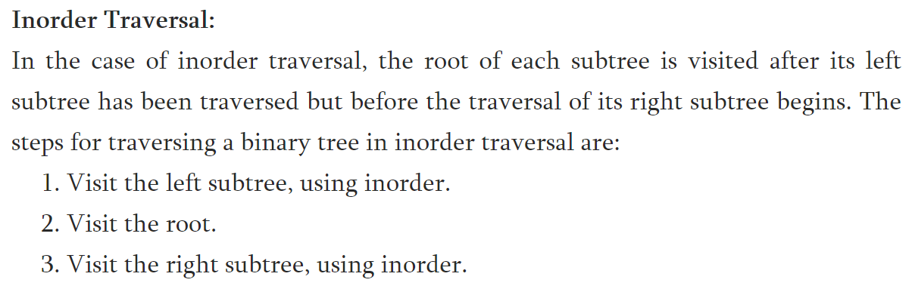
BINARY TREE TRAVERSALS
In-Order Traversal (Leftchild - Root - Rightchild )

Slide 52
IN ORDER TRAVERSAL
A
B
C
BAC

Slide 53
IN ORDER TRAVERSAL
a
1. Visit Left Subtree
12. Visit Right Subtree
b
11. Traverse Back.
Print the value: a
c
2. Visit Left Subtree
7. Visit Right Subtree.
13. Visit Left Subtree
18. Visit Right Subtree.
6. Traverse Back.
Print the value: b
17. Traverse Back.
Print the value: c
d
f
e
g
3. Left Subtree is NULL
4. Print the Value: d
5. Right Subtree is NULL
8. Left Subtree is NULL
9. Print the Value: e
10. Right Subtree is NULL
14. Left Subtree is NULL
15. Print the Value: f
16. Right Subtree is NULL
19. Left Subtree is NULL
20. Print the Value: g
21. Right Subtree is NULL
d
b
e
a
f
c
g

Slide 54
BINARY TREE TRAVERSALS
In-Order Traversal (Leftchild - Root - Rightchild )
In-Order Traversal for above example of binary tree is :
I - D - J - B - F - A - G - K - C - H

Slide 55
BINARY TREE TRAVERSALS
In-Order Traversal (Leftchild - Root - Rightchild )
+
*
E
*
D
/
C
A / B * C * D + E
A
B

Slide 56
BINARY TREE TRAVERSAL USING RECURSIVE APPROACH
INORDER USING RECURSIVE:
Inorder (ROOT)
Temp = ROOT
If Temp = = NULL
Return
End If
If Left(Temp) != NULL
Inorder (Left(Temp))
End If
Print (Temp)
If Right(Temp) != NULL
Inorder(Right(Temp))
End If
End Inorder
P
Q
R
S
T
TU
S -> Q -> T -> P -> U -> R

Slide 57
Inorder(P)
Temp = P
P != Null
If Left (P) != Null // Left(P) = Q
Inorder (Q)
End if
Print Temp // P
If Right(P)!= Null //Right(P) = R
Inorder(R)
End if
End Inorder(P)
Inorder(Q)
Temp = Q
Q != Null
If Left (Q) != Null // Left(Q) = S
Inorder (S)
End if
Print Temp // Q
If Right(Q)!= Null //Right(Q) = T
Inorder(T)
End if
End Inorder(Q)
Inorder(S)
Temp = S
S != Null
If Left (S) != Null // Left(S) = NULL
Inorder () // Not Called
End if
Print Temp // S
If Right(S)!= Null //Right(S) = NULL
Inorder() // Not Called
End if
End Inorder(S)
1
2
3
P
Q
R
S
T
TU
S -> Q -> T -> P -> U -> R
Inorder(T)
Temp = T
T != Null
If Left (T) != Null // Left(T) = NULL
Inorder () // Not Called
End if
Print Temp // T
If Right(T)!= Null //Right(T) = NULL
Inorder() // Not Called
End if
End Inorder(T)
Inorder(R)
Temp = R
R != Null
If Left (R) != Null // Left(R) = U
Inorder (U)
End if
Print Temp // R
If Right(R)!= Null //Right(R) = NULL
Inorder() // Not Called
End if
End Inorder(R)
Inorder(U)
Temp = U
U != Null
If Left (U) != Null // Left(U) = NULL
Inorder () // Not Called
End if
Print Temp // U
If Right(U)!= Null //Right(U) = NULL
Inorder() // Not Called
End if
End Inorder(U)
4
5
6

Slide 58
ROOT = P
Step 1: Inorder (ROOT) // Inorder (P)
Step 2: Temp = ROOT // Temp = P
Step 3,4,5: Fails
Step 6: Left(Temp)=NULL
// Left(Temp) = Q
Step 7: Inorder(Q)
Step 1: Inorder(ROOT) // Assume Q
Step 2: Temp = Q
Step 6: Left (Q) = NULL
Step 7: Left(Temp) = NULL
// Left(Temp) = S
Step 1: Inorder (ROOT) // Assume S
Step 2: Temp = S
Step 3: Fails
Step 9: Print(Temp)
OUTPUT : S
ROOT = Q
Step 10: Right(Temp) = Null
// Right(Temp) = T
Step 11: Inorder(Right (Temp))
// Inorder(T)
Step 1: Inorder(T)
Step 2: Temp = ROOT // Temp = T
Step 3: Fails
Step 9: Print(Temp)
OUTPUT: S Q T
ROOT = Q
Step 1: Inorder(ROOT) // Assume Q
Step 2: Temp = ROOT // Temp = Q
Step 3,6: Fails, Already Visited
Step 9: Print(Temp)
OUTPUT: S Q
1
P
2
INORDER USING RECURSIVE:
Inorder (ROOT)
Step 2: Temp = ROOT
Step 3: If Temp == NULL
Step 4: Return
Step 5: End If
Step 6: If Left(Temp) != NULL
Step 7: Inorder (Left(Temp))
Step 8: End If
Step 9: Print (Temp)
Step 10 :If Right(Temp) != NULL
Step 11: Inorder(Right(Temp))
Step 12: End If
Step 13: End Inorder
Q
R
P
3
2
Q
R
S
T
U
3
P
S
T
U
Q
R
1
S
T
U
ROOT = P
Step 10: Right (Temp) = NULL
// Right (Temp) = R
Step 11: Inorder( R)
Step 1: Inorder (ROOT) // Assume R
Step 2: Temp = ROOT
Step 3: Fails
Step 6: Left(Temp) = NULL // U
Step 7: Inorder(U)
Step 1: Inorder(ROOT) // Assume U
Step 2: Temp = U
Step 3: fails
Step 9: Print (Temp)
OUTPUT: S Q T P U
ROOT = R
Step 1: Inorder(ROOT) // Inorder(R)
Step 2: Temp = ROOT // Temp = R
Step 3: Fails
Step 9: Print( Temp)
OUTPUT: S Q T P U R
Step 13: End
ROOT = P
Step 1: Inorder(P)
Step 2: Temp = ROOT // Temp = P
Step 3: Fails
Step 6: Already Visited
Step 9: Print (Temp)
OUTPUT: S Q T P
6
4
5
6
P
P
5
P
Q
R
Q
R
Q
R
4
S
T
U
S
T
U
S
T
U

Slide 59
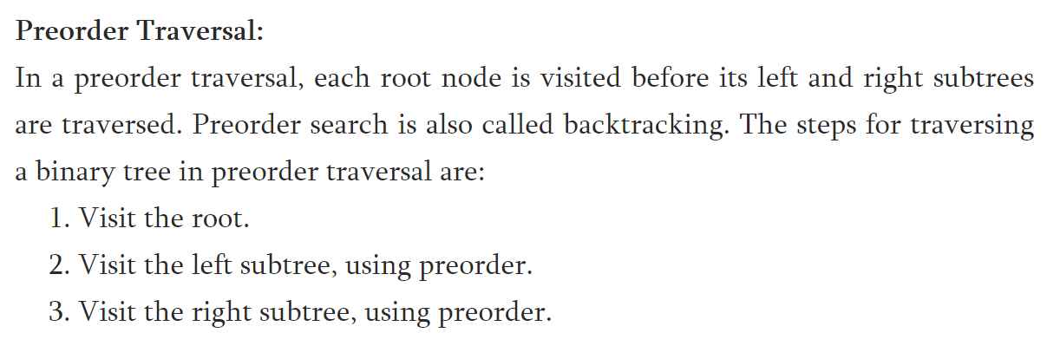
BINARY TREE TRAVERSALS
Pre-Order Traversal (Root - Leftchild - Rightchild)

Slide 60
PRE ORDER TRAVERSAL
A
B
C
ABC

Slide 61
PRE ORDER TRAVERSAL
a
1. Print the Value: a
2. Visit Left Sub Tree
12. Visit Right Sub Tree
b
13. Print the Value: c
14. Visit Left Sub Tree
c
3. Print the Value: b
4. Visit Left Sub Tree
15. Visit Right Sub Tree
8. Visit Right Sub Tree
d
e
f
g
5. Print the Value: d
6. Left Sub Tree is NULL
7. Right Sub Tree is NULL
9. Print the Value: e
10. Left Sub Tree is NULL
11. Right Sub Tree is NULL
15. Print the Value: f
16. Left Sub Tree is NULL
17. Right Sub Tree is NULL
18. Print the Value: g
19. Left Sub Tree is NULL
20. Right Sub Tree is NULL
a
b
d
e
c
f
g

Slide 62
BINARY TREE TRAVERSALS
Pre-Order Traversal (Root - Leftchild - Rightchild)
+
*
E
*
D
/
C
+ * * / A B C D E
A
B

Slide 63
BINARY TREE TRAVERSALS
Pre-Order Traversal (Root – Leftchild- Rightchild )
Pre-Order Traversal for above example of binary tree is :
A - B - D - I - J - F - C - G - K - H

Slide 64
BINARY TREE TRAVERSALS
Pre-Order Traversal (Root - Leftchild - Rightchild )
PREORDER USING RECURSIVE:
Preorder (ROOT)
Temp = ROOT
If Temp = = NULL
Return
End If
Print (Temp)
If Left(Temp) != NULL
Preorder (Left(Temp))
End If
If Right(Temp) != NULL
Preorder(Right(Temp))
End If
End Preorder
P
Q
R
S
T
TU
P -> Q -> S -> T -> R -> U

Slide 65
Preorder(P)
Temp = P
P != Null
Print Temp // P
If Left (P) != Null // Left(P) = Q
Preorder (Q)
End if
If Right(P)!= Null //Right(P) = R
Preorder(R)
End if
End Preorder(P)
Preorder(Q)
Temp = Q
Q != Null
Print Temp // Q
If Left (Q) != Null // Left(Q) = S
Preorder (S)
End if
If Right(Q)!= Null //Right(Q) = T
Preorder(T)
End if
End Preorder(Q)
Preorder(S)
Temp = S
S != Null
Print Temp // S
If Left (S) != Null // Left(S) = NULL
Preorder () // Not Called
End if
If Right(S)!= Null //Right(S) = NULL
Preorder() // Not Called
End if
End Preorder(S)
1
2
3
P
Q
R
S
T
TU
P -> Q -> S -> T -> R -> U
Preorder(T)
Temp = T
T != Null
Print Temp // T
If Left (T) != Null // Left(T) = NULL
Preorder () // Not Called
End if
If Right(T)!= Null //Right(T) = NULL
Preorder() // Not Called
End if
End Preorder(T)
Preorder(R)
Temp = R
R != Null
Print Temp // R
If Left (R) != Null // Left(R) = U
Preorder (U)
End if
If Right(R)!= Null //Right(R) = NULL
Preorder() // Not Called
End if
End Preorder(R)
Preorder(U)
Temp = U
U != Null
Print Temp // U
If Left (U) != Null // Left(U) = NULL
Preorder () // Not Called
End if
If Right(U)!= Null //Right(U) = NULL
Preorder() // Not Called
End if
End Preorder(U)
4
5
6

Slide 66
Temp = P
Step 7: Left(Temp) = NULL
// Left(Temp) = Q
Step 8: Preorder(Left(Temp))
// Preorder (Q)
Step 1: Preorder(ROOT) // Assume Q
Step 2: Temp = ROOT // Temp = Q
Step 3: Fails
Step 6: Print (Temp)
OUTPUT : P Q
Temp = Q
Step 7: Left(Temp) = NULL
// Left(Temp) = S
Step 8: Preorder (Left(Temp))
// Preorder (S)
Step 1: Preorder(ROOT) //Assume S
Step 2: Temp = ROOT // Temp = S
Step 3: Fails
Step 6: Print (Temp)
OUTPUT : P Q S
3
P
Q
R
PREORDER USING RECURSIVE:
Step1: Preorder (ROOT)
Step2: Temp = ROOT
Step3: If Temp = = NULL
step4: Return
Step5: End If
Step 6: Print (Temp)
Step7: If Left(Temp) != NULL
Step8: Preorder (Left(Temp))
Step9: End If
Step10: If Right(Temp) != NULL
Step11: Preorder(Right(Temp))
Step12: End If
Step13: End Preorder
S
T
U
2
3
ROOT = P
Step 1: Function call Preorder(ROOT) // Preorder (P)
Step 2: Temp = Root // Temp = P
Step 3: Fails
Step 6: Print (Temp)
OUTPUT : P
P
2
P
Temp = R
Step 7: Left(Temp) = NULL
// Left(Temp) = U
Step 8: Preorder (Left(Temp))
// Preorder(U)
Step 1: Preorder(ROOT) // Assume U
Step 2: Temp = ROOT // Temp = U
Step 3: Fails
Step 6: Print (Temp)
OUTPUT: P Q S T R U
Step 13: End
6
1
Q
R
Q
R
P
S
T
U
S
T
U
1
Q
R
S
T
U
ROOT = P , Temp = P
Step 10: Right (Temp) = NULL
// Right(Temp) = R
Step 11: Preorder (Right (Temp))
// Preorder (R)
Step 1: Preorder(ROOT) // Preorder (R )
Step 2: Temp = ROOT // Temp = R
Step 3: Fails
Step 6: Print (Temp)
OUTPUT: P Q S T R
6
Temp = Q
Step 10: Right(Temp) = NULL
// Right(Temp) = T
Step 11: Preorder(Right(Temp))
// Preorder(T)
Step 1: Preorder(ROOT) // Assume T
Step 2: Temp = ROOT // Temp = T
Step 3: Fails
Step 6: Print( Temp)
OUTPUT: P Q S T
P
Q
R
P
S
T
U
4
Q
R
5
S
U
4
T
5

Slide 67
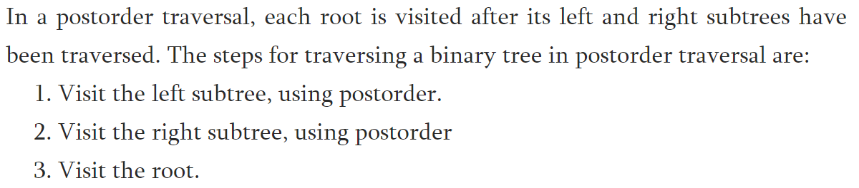
BINARY TREE TRAVERSALS
Post-Order Traversal (Leftchild – Rightchild - Root)

Slide 68
POST ORDER TRAVERSAL
A
B
C
BCA

Slide 69
POST ORDER TRAVERSAL
a
1. Visit Left Sub Tree
20. Print the Value: a
11. Visit Right Sub Tree
b
c
15. Visit Right Sub Tree
2. Visit Left Sub Tree
10. Print the Value: b
12. Visit Left Sub Tree
19. Print the Value: c
6. Visit Right Sub Tree
d
e
f
g
3. Left Sub Tree is NULL
4 Right Sub Tree is NULL
5. Print the Value: d
13. Left Sub Tree is NULL
14. Right Sub Tree is NULL
15. Print the Value: f
7. Left Sub Tree is NULL
8. Right Sub Tree is NULL
9. Print the Value: e
16. Left Sub Tree is NULL
17. Right Sub Tree is NULL
18. Print the Value: g
d
e
d
f
g
c
a

Slide 70
BINARY TREE TRAVERSALS
Post-Order Traversal (Leftchild – Rightchild- Root)
+
*
E
*
D
/
C
A B / C * D * E +
A
B

Slide 71
BINARY TREE TRAVERSALS
Post-Order Traversal ( Leftchild - Rightchild - Root )
Post-Order Traversal for above example of binary tree is :
I - J - D - F - B - K - G - H - C - A

Slide 72
BINARY TREE TRAVERSALS
Post-Order Traversal ( Leftchild - Rightchild - Root )
POSTORDER USING RECURSIVE:
POSTORDER(ROOT)
Temp = ROOT
If temp = NULL
Return
End if
If left(temp) ≠ NULL
POSTORDER(left(temp))
End if
If right(temp) ≠ NULL
POSTORDER(right(temp))
End if
Print (temp)
End POSTORDER
P
Q
R
S
T
TU
S -> T -> Q -> U -> R -> P

Slide 73
Postorder(P)
Temp = P
P != Null
If Left (P) != Null // Left(P) = Q
Postorder (Q)
End if
If Right(P)!= Null //Right(P) = R
Postorder(R)
End if
Print Temp // P
End Postorder(P)
Postorder(Q)
Temp = Q
Q != Null
If Left (Q) != Null // Left(Q) = S
Postorder(S)
End if
If Right(Q)!= Null //Right(Q) = T
Postorder(T)
End if
Print Temp // Q
End Postorder(Q)
Postorder(S)
Temp = S
S != Null
If Left (S) != Null // Left(S) = NULL
Postorder() // Not Called
End if
If Right(S)!= Null //Right(S) = NULL
Postorder() // Not Called
End if
Print Temp // S
End Postorder(S)
1
2
3
P
Q
R
S
T
TU
S -> T -> Q -> U -> R -> P
Postorder(T)
Temp = T
T != Null
If Left (T) != Null // Left(T) = NULL
Postorder () // Not Called
End if
If Right(T)!= Null //Right(T) = NULL
Postorder() // Not Called
End if
Print Temp // T
End Postorder(T)
Postorder(R)
Temp = R
R != Null
If Left (R) != Null // Left(R) = U
Postorder (U)
End if
If Right(R)!= Null //Right(R) = NULL
Postorder() // Not Called
End if
Print Temp // R
End Postorder(R)
Postorder(U)
Temp = U
U != Null
If Left (U) != Null // Left(U) = NULL
Postorder () // Not Called
End if
If Right(U)!= Null //Right(U) = NULL
Postorder() // Not Called
End if
Print Temp // U
End Postorder(U)
4
5
6

Slide 74
ROOT = P
Step 1: Temp = ROOT // Temp = P
Step 2: Fails
Step 5: Left(Temp) = Q
Step 6: POSTORDER( Q)
Step 1: Temp = ROOT // Temp = Q
Step 2: Fails
Step 5: left(Q) = S
Step 6: POSTORDER(S)
Step 1: Temp = S
Step 2: Fails
Step 5: Fails
Step 8: Fails
Step 11: Print(Temp)
OUTPUT: S
3
1
ROOT = Q
Step 8: Right(Temp) = T
Step 9: POSTORDER (T)
Step 1: Temp = T
Step 2: Fails
Step 11: Print(Temp)
OUTPUT: S T
ROOT = Q
Step 1: Temp = Q
Step 2: Fails
Step 5: Already visited
Step 8: Already visited
Step 11:Print(Temp)
OUTPUT: S T Q
P
Q
R
P
2
3
S
T
U
Q
R
P
2
S
T
U
Q
R
ROOT = P
Step 1: Temp = P
Step 2: Fails
Step 5: Already visited
Step 8: Already visited
Step 11:Print(temp)
OUTPUT: S T Q U R P
Step 2: temp = Null
Step 4: End
Step 12:End
POSTORDER USING RECURSIVE:
POSTOREDER(ROOT)
Step 1: Temp = ROOT
Step 2: If temp = NULL
Step 3: Return
Step 4: End if
Step 5: If left(temp) ≠ NULL
Step 6: POSTORDER(left(temp))
Step 7: End if
Step 8: If right(temp) ≠ NULL
Step 9: POSTORDER(right(temp))
Step 10:End if
Step 11:Print (temp)
Step 12:End POSTORDER
ROOT = P
Step 1: Temp = Root
Step 2: Fails
Step 8: Right(Temp) = R
Step 9: POSTORDER (R)
Step 1: Temp = R
Step 2: Fails
Step11:Print(Temp)
OUTPUT: S T Q U R
1
S
T
U
ROOT = P
Step 1: Temp = P
Step 2: Fails
Step 5: Fails
Step 6: Right(Temp) = R
Step 7: POSTORDER (R)
Step 1: Temp = R
Step 2: Fails
Step 5:left(temp) = U
Step 6: POSTORDER(U)
Step 1: Temp = U
Step 2: Fails
Step 5: Fails
Step 6: Fails
Step 11: Print(Temp)
OUTPUT: S T Q U
4
5
P
6
Q
R
P
P
Q
R
S
T
U
6
5
Q
R
4
S
T
U
S
T
U

Slide 75
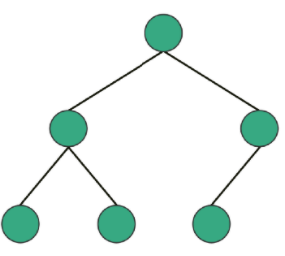
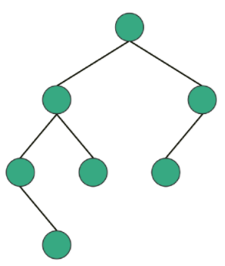
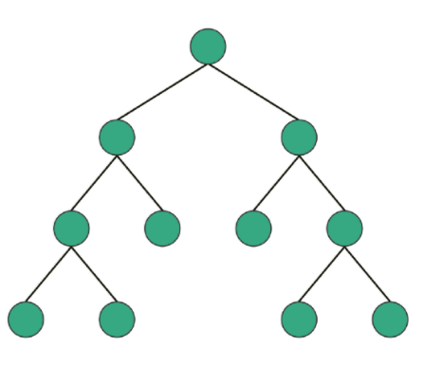
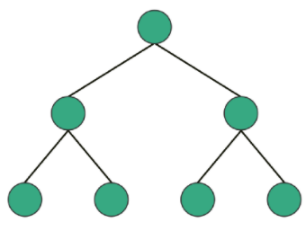
Complete Binary Tree
Balanced Binary Tree
Full Binary Tree
Perfect Binary Tree
Notes:
Full Binary Tree is a Binary Tree in which every node has 0 or 2 children.
Interesting Fact: For Full Binary Tree, following equation is always true.
Number of Leaf nodes = Number of Internal nodes + 1
Complete Binary Tree has all levels completely filled with nodes except the last level and in the last level,
all the nodes are as left side as possible.
Perfect Binary Tree is a Binary Tree in which all internal nodes have 2 children and all the leaf nodes are at the same depth or same level. Interesting Fact: Total number of nodes in a Perfect Binary Tree with height H is 2^H — 1.

Slide 76
BINARY TREE TRAVERSAL
IN ORDER: LEFT CHILD -> ROOT NODE -> RIGHT CHILD
PRE ORDER: ROOT NODE -> LEFT CHILD -> RIGHT CHILD
POST ORDER: LEFT CHILD -> RIGHT CHILD -> ROOT NODE
Binary tree traversal can be implemented :
Recursive Approach
Iterative Approach
Recursive | Iterative
Execute the set of instructions repeatedly It is a method call where the method being called is the same as one making call (Function call itself) | Execute the set of instructions repeatedly Loop is repeated until the certain condition met

Slide 77
BINARY TREE TRAVERSALS
In-Order Traversal ( Leftchild – Root - Rightchild )
1. Start with Current Node(Root) and mark Node as visited.
2. Push the Node in the stack and visit it’s Left Child.
3. Repeat step 2 while Node is not NULL,
if it's NULL then
Pop it's parent (i.e. the last node in stack) and Print it.
4. Now move to Node’s Right Child and repeat from step 1
5. Repeat whole procedure while Node is not NULL and stack is
not empty

Slide 78
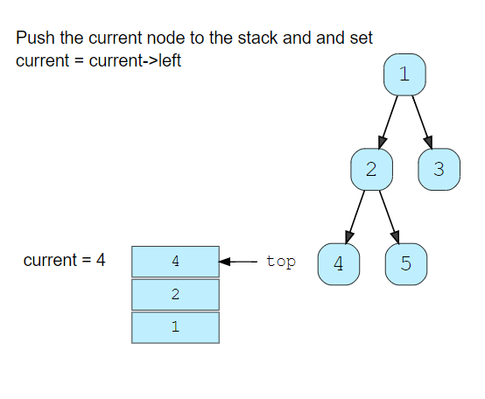
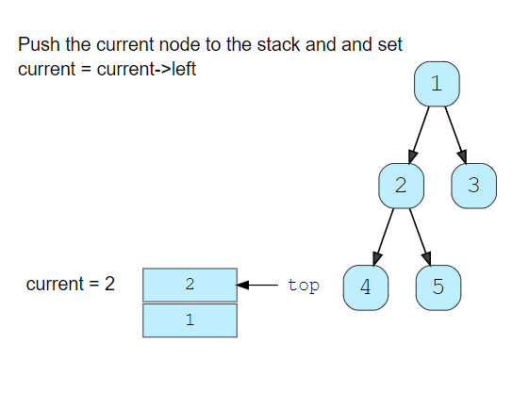
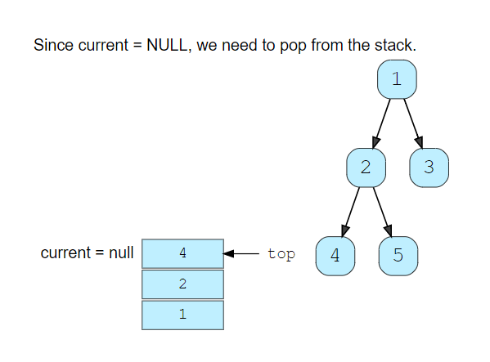
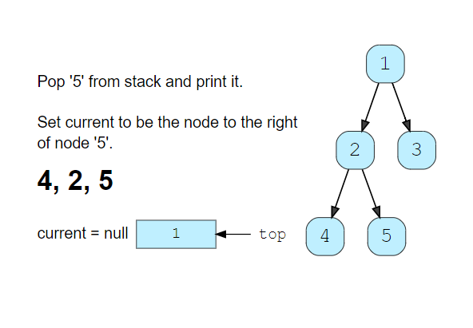
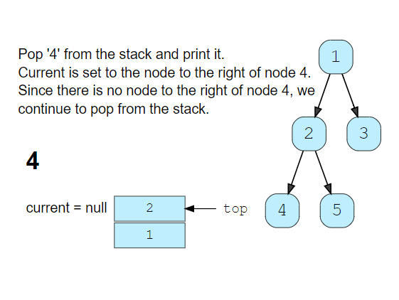
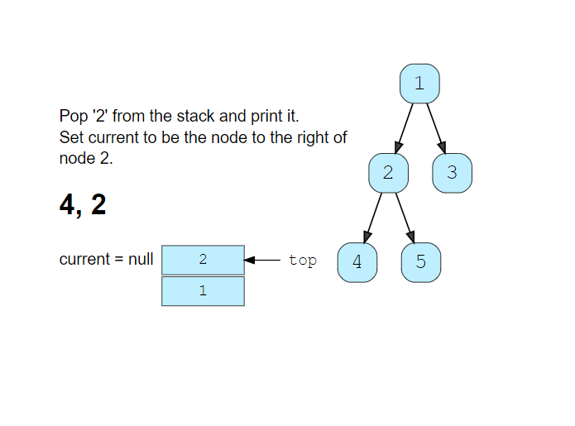
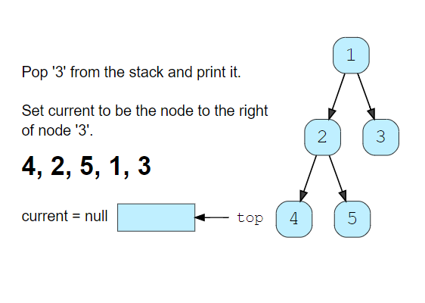
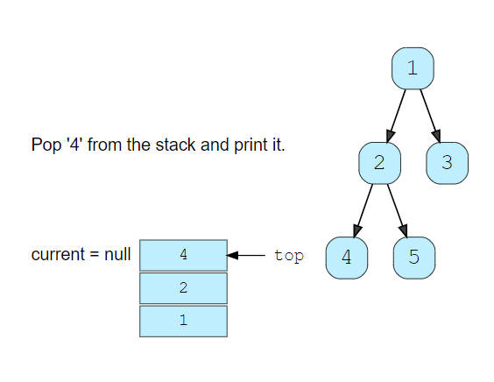
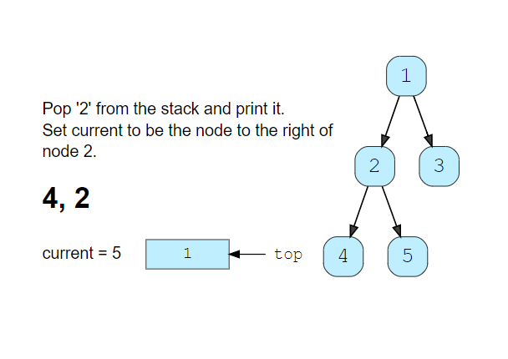
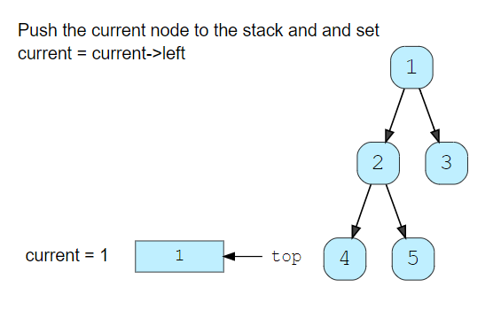
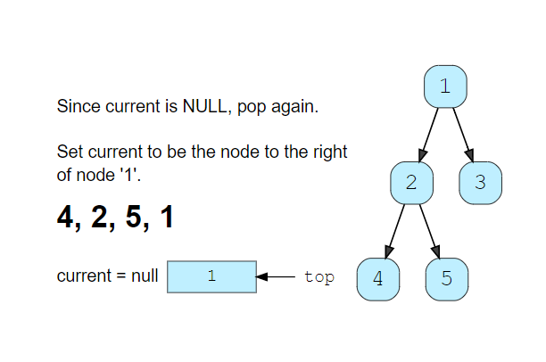
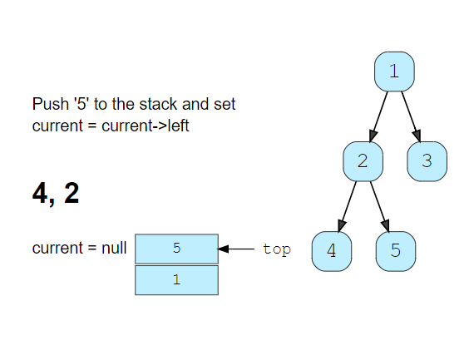
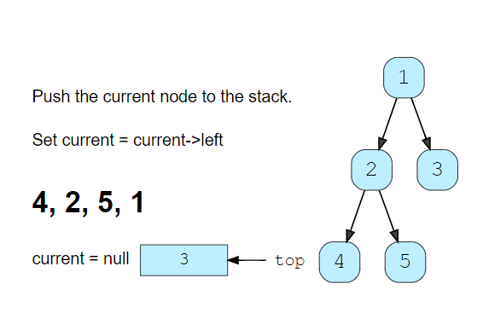
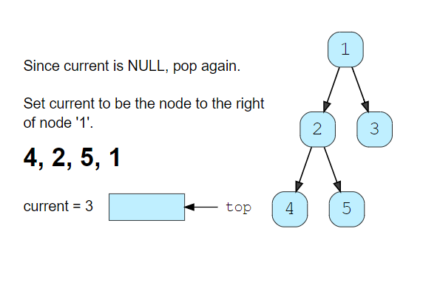
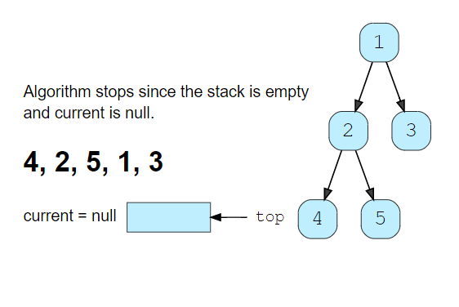
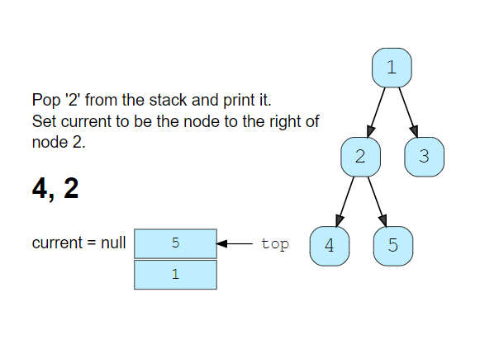
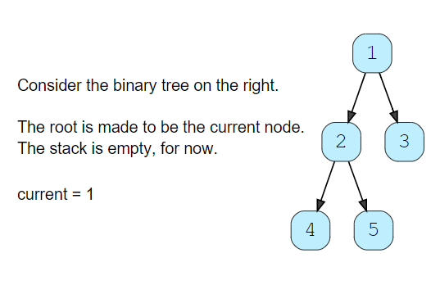
BINARY TREE TRAVERSALS
In-Order Traversal ( Leftchild – Root - Rightchild )
Notes:
https://www.educative.io/edpresso/how-to-perform-an-iterative-inorder-traversal-of-a-binary-tree

Slide 79
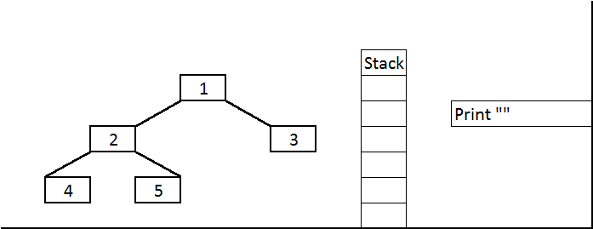
BINARY TREE TRAVERSALS
In-Order Traversal (Leftchild – Root - Rightchild)
PSEUDO-CODE:
Create empty stack
Push the Current Node (Starting with Root Node)
onto stack and
while Left(Current) != NULL
Push(Left(Current)
3. While Current node is NULL and Stack is not empty:
a. Pop node from the stack and Print it
b. Set Current Node as the Right child of
popped node to stack.
c. Repeat Step 2.
4. Ends when Stack is Empty and Current Node=NULL

Slide 80
BINARY TREE TRAVERSALS
Pre-Order Traversal (Root - Leftchild - Rightchild)
1. Start with an Empty Stack and Root Node as Current Node.
2. Push the Current Node (Root) into the stack
3. While Stack is not Empty
a. Pop a Node and (i.e, first time Root Node) and Print it.
b. Push Right Child (if present) of Popped Node.
c. Push Left Child (if present) of Popped Node.
4. Repeat whole procedure while Node is not NULL and stack is
not empty

Slide 81
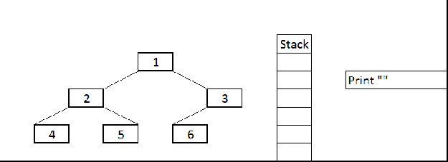
BINARY TREE TRAVERSALS
Pre-Order Traversal (Root - Leftchild - Rightchild)
Pseudo-Code:
Create empty stack
Push root node onto stack
While our stack is not empty:
a. pop node from the stack and print it
b. push right child of popped node to stack
c. push left child of popped node to stack

Slide 82
BINARY TREE TRAVERSALS
Post-Order Traversal (Leftchild – Rightchild - Root)
1. Start with an Empty Stack and Root Node as Current Node.
2. Push the Current Node (Root) into the stack 1.
3. While Stack1 is not Empty
a. Pop a Node and (i.e, first time Root Node) and Push it
into Stack2.
b. Push Left Child (if present) of Popped Node.
c. Push Right Child (if present) of Popped Node.
4. Repeat whole procedure while Node is not NULL and stack is
not empty.
5. Pop all the elements of Stack2 and Print it

Slide 83
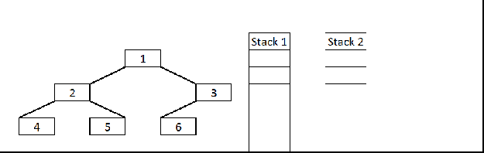
BINARY TREE TRAVERSALS
Post-Order Traversal (Leftchild – Rightchild - Root)
If you just observe here, postorder traversal is just reverse of preorder traversal (1 3 6 2 5 4 if we traverse the right node first and then left node.)
So idea is follow the same technique as preorder traversal and instead of printing it push it to the another Stack so that they will come out in reverse order (LIFO).
At the end just pop all the items from the second Stack and print it.

Slide 84
BINARY TREE TRAVERSALS
Traversing a tree
Before we dive into the binary search trees, the two general ways of traversing any tree:
1. Depth-first search 2. Breadth-first search.
Depth-first search
The three most common traversal orders for depth-first search are:
Pre-order traversal
In-order traversal
Post-order traversal
Breadth-first search
Often called as Level Order Traversal.
This means that the root layer (containing one node) will always be visited first, then all nodes in the next layer, etc.
Notes:
Depth-first traversal is a technique in which branches of a tree will be fully explored before taking steps back and traversing other branches/leaves.
Breadth-first search
The other way of traversing a tree is breadth-first search, where the different layers of a tree will be traversed one-by-one.
This means that the root layer (containing one node) will always be visited first, then all nodes in the next layer, etc.
In practice, this is usually done by putting nodes to visit in a queue. Using a queue guarantees certain nodes (those less deep in the tree) will be visited/processed first.

Slide 85
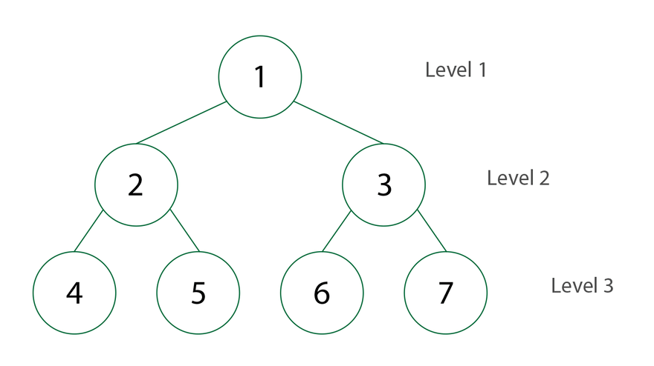
BINARY TREE TRAVERSALS
BREADTH FIRST SEARCH
Level Order Traversal
Visit the root first
Visit the roots left child
Visit the roots right child
Continue the traverse at each level
Employs Queue Data Structure

Slide 86
BINARY TREE TRAVERSALS
BREADTH FIRST SEARCH
queue
root
a
a
Print a
b | c
b
c
Print b
c | d | e
Print c
d | e | f | g
d
e
f
g
Print d
e | f | g
Print e
f | g
Print f
g
Print g

Slide 87
BINARY SEARCH TREES (BST)
A Binary Search Tree is a binary Tree.
It may be empty.
If it is not empty then it satisfies the following properties:
Every element has a key and no two elements have the same key
The keys (if any) in the left subtree are smaller than the key in the root.
The keys (if any) in the right subtree are greater than the key in the root.
The left and right subtrees are also binary search trees.

Slide 88
BINARY SEARCH TREES (BST)
20 10 25
50 75 25 35 15 65 85
50
20
10
25
25
75
15
35
65
85

Slide 89
BINARY SEARCH TREES (BST)
100 90 80 70 60
60 70 80 90 100
60
100
70
90
80
80
90
70
100
60

Slide 90
BINARY SEARCH TREES (BST)
92 93 90 91 88 89 87
92
90
93
88
91
87
89

Slide 91




BINARY SEARCH TREE

Slide 92
BINARY SEARCH TREE (BST) - ADT
Search (x)
Insertion(x)
Deletion(x)
Minimum()
Maximum()
Predecessor(x)
Successor(x)
Traverse()
In-Order
Pre-Order
Post-Order

Slide 93




BINARY SEARCH TREE (BST) - SEARCH
Search (root, X)
temp=root; par=NULL; Loc=NULL
If root == NULL
return NULL;
else
while temp != NULL
if X == temp -> data
Loc =temp;
return Loc;
else if X < temp -> data
par = temp
temp = temp -> left
else
par = temp
temp = temp -> right
end if
end while
endif
SEARCH(4)
Search (root, X)
If Loc != NULL
Write “Element Found”
else
Write “Not Found”
endif
SEARCH ELEMENT 4 FOUND

Slide 94

BINARY SEARCH TREE (BST) - INSERTION
Insert (10)
Insert (5)

Slide 95

BINARY SEARCH TREE (BST) - INSERTION
INSERT( ROOT, X )
temp = ROOT, Par = NULL
while temp ≠ NULL
if X == temp → Data
write “Element exists!”
return
end if
else if X < temp → Data
Par = temp
temp = temp → Left
else
Par = temp
temp = temp → Right
end if
end while
INSERT (Root, X)
N→Data=X; N→Left=NULL; N→Right=NULL;
if Par = NULL
ROOT = N
else if X < Par→data
Par→Left = N
else
Par→Right = N
end if
end INSERT

Slide 96


BINARY SEARCH TREE (BST) - DELETION
Case 0 – Leaf Node
if X has no children
then remove X

Slide 97


BINARY SEARCH TREE (BST) - DELETION
Case 1 – Node with one Child
if X has one child
then Make Par[X] point to child

Slide 98


BINARY SEARCH TREE (BST) - DELETION
Case 1 – Node with one Child
if X has one child
then Make Par[X] point to child
X =

Slide 99


BINARY SEARCH TREE (BST) - DELETION
Case 2 – Node with Two Child
if X has two children (subtrees)
then
Swap X with its successor
Perform case 0 or case 1 to Delete it
X =
Replace with Leftmost node of the right subtree or rightmost node of the left subtree.

Slide 100




BINARY SEARCH TREE (BST) - DELETION
2
1
3
4

Slide 101



BINARY SEARCH TREE (BST) - DELETION
5
6

Slide 102
BINARY SEARCH TREE
(BST) - DELETION
CASEA( Loc, par )
Temp = Loc→Right
Save = Loc
while Temp→Left ≠ NULL
Save = Temp
Temp = Temp→Left
end while
Suc = Temp
Parsuc = Save
CASEB( suc, parsuc)
if Par ≠ NULL
if Loc = Par→Left
Par→Left = Suc
else
Par→Right = Suc
end if
else
ROOT = Suc
end if
Suc→Left = Loc→Left
Suc→Right = Loc→Right
end CASEA
CASEB(Loc, Par )
Temp = Loc
if Temp → Left = NULL and
Temp→Right= NULL
Child = NULL
else
if Temp→Left ≠ NULL
Child = Temp→Left
else
Child = Temp→Right
end if
end if
if Par ≠ NULL
if Temp = Temp→Left
Par→Left = Child
else
Par→Right = Child
end if
else
ROOT = Child
end if
end CASEB
DELETE( ROOT, k )
SEARCH( ROOT, k )
if Loc = NULL
Write “Element not found”
return
end if
if Loc→Right ≠ NULL and
Loc→Left ≠ NULL
CASEA(Loc, par)
else
CASEB(Loc, par)
end if
end DELETE

Slide 103
BINARY SEARCH TREE (BST) - DELETION
K
CASE A
DELETE( ROOT, k )
SEARCH( ROOT, k )
//Returns Par and Loc
if Loc = NULL
Write “Element not found”
return
end if
if Loc→Right ≠ NULL and
Loc→Left ≠ NULL
CASEA(Loc, par)
else
CASEB(Loc, par)
end if
end DELETE
G
M
X =
D
H
L
N
K
K
G
M
X =
G
M
X =
CASE B.a
L
N
D
L
N
CASE B.b

Slide 104
BST-DELETION (CASEB)
CASEB (Loc, Par )
Temp = Loc
if Temp → Left = NULL and
Temp→Right= NULL
Child = NULL
else
if Temp→Left ≠ NULL
Child = Temp→Left
else
Child = Temp→Right
end if
end if
if Par ≠ NULL
if Temp = Temp→Left
Par→Left = Child
else
Par→Right = Child
end if
else
ROOT = Child
end if
end CASEB
K
K
Loc / Temp
G
M
M
X =
Child = NULL
L
L
N
N
K
K
X =
G
M
D
M
D
L
N
L
N
Child

Slide 105
BST-DELETION (CASEA)
CASEA( Loc, par )
Temp = Loc→Right
Save = Loc
while Temp→Left ≠ NULL
Save = Temp
Temp = Temp→Left
end while
Suc = Temp
Parsuc = Save
CASEB( suc, parsuc)
if Par ≠ NULL
if Loc = Par→Left
Par→Left = Suc
else
Par→Right = Suc
end if
else
ROOT = Suc
end if
Suc→Left = Loc→Left
Suc→Right = Loc→Right
end CASEA
Par
ParSuc
K
K
Loc / Save
H
M
G
Suc
M
X =
Temp
L
N
D
H
L
N
D
G
Suc
D
NULL
H
Traverse to the leftmost child of the Right Subtree and mark it as Suc and its parent and Parsuc respectively.

Slide 106
BST-DELETION (CASEA)
Par
Par
Save
K
Loc
K
K
Suc
G
M
G
X =
G
O
Save
ParSuc
D
D
H
L
P
D
H
H
L
P
Temp
O
R
P
Suc
N
R
N
Suc
N
R
O

Slide 107
BINARY SEARCH TREE
Complexity Analysis
Operation | Best case Complexity | Average case Complexity | Worst case Complexity
Search | O(log n) | O(log n) | O(n)
Insertion | O(log n) | O(log n) | O(n)
Deletion | O(log n) | O(log n) | O(n)
Space complexity | O(n) | O(n) | O(n)
Here n represents the number of nodes in the Tree

Slide 108
BINARY SEARCH TREE - Applications
In multilevel indexing in the database
For dynamic sorting
For managing virtual memory areas in Unix kernel

Slide 109
Exercises
Construct binary tree from given traversals sequences
In order: 2,1, 3
Post order: 2, 3, 1
In order: 4, 8, 2, 5, 1, 6, 3, 7
Post order: 8, 4, 5, 2, 6, 7, 3, 1
3) In order: 9, 3, 15, 20, 7
Post order: 9, 15, 7, 20, 3
4) In order: 2, 5, 6, 10, 12, 14, 15
Post order: 2, 6, 5, 12, 15, 14, 10

